Slide 1
TRICKS OF THE TRADE
Procedural Writing + Presentation Tips

Slide 2
How Can I Create Some Great Procedural Instructions For This Project???
Some Tips…
#1 Choose a REALISTIC NEW SKILL!
How much time do you have?
What type of materials do you have available at home?
Are your parents/guardians willing to chip in some $ for materials?
Is your skill safe and approved by the adult in your family?

Slide 3
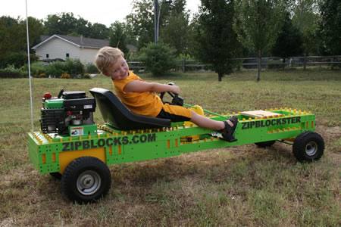
CHOOSE A REALISTIC/TIMELY SKILL…
An example of an UNREALISTIC skill…
BUILDING A GO-KART
This is a great skill or goal to save for when you have more time. :)
Can you finish it and create instructions in a few weeks while doing work for other classes?
Money? Parts? Available at home?

Slide 4
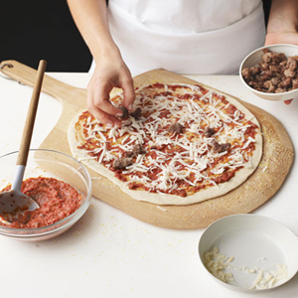
CHOOSE A REALISTIC/TIMELY SKILL
Examples of REALISTIC skills…
Change the Oil on a Go-Kart
Cook a Great Meal
Bake a Dessert
Snowboard/Skateboard Trick
A Safe Magic Trick
***These can all be mastered in a few weeks,
with little or no $$$, and time left over to
create your instructions and presentation
***They have clear procedural steps too!

Slide 5
#2 IMAGINE YOUR AUDIENCE HAS NO PRIOR KNOWLEDGE
Imagine they have NO CLUE about your skill or how to do it well.
What little details do you need to make them aware of?
Put yourself in their shoes.
Imagine the skill from their perspective.

Slide 6
#3 TARGET YOUR TASKS
Examine your skill
Look up instructions or tutorials
Break the skill down into simple/clear
target tasks the audience can easily master

Slide 7
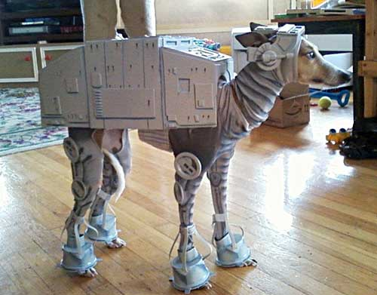
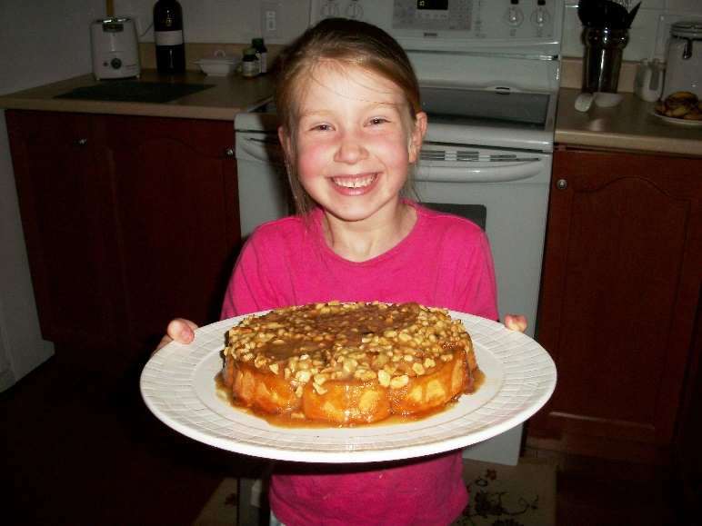
#4 BEGIN AT THE END!
What does that mean???
At beginning of your presentation, show the audience an example of the finished product.
Helps them VISUALIZE and get interested in what you’re going to show them.
Could be a photo, short video clip, or you could bring the sample/example to class to show.

Slide 8
#5 USE COMMAND WORDS AND TOOLS IN YOUR INSTRUCTIONS
Words that clearly show what needs to be done
Unclear Instruction Step | Clear Instruction Step
50 ml of water | Measure 50 ml of water and pour it into a mixing bowl
Flour, milk and water | Use a whisk to gently mix the flour, milk and water together into a thick paste with no lumps
Tools – Mixer, Hammer, Funnel, etc
Adverbs – Gently, Quickly, etc
Command Verbs – Pour, Fold, Cut, etc

Slide 9
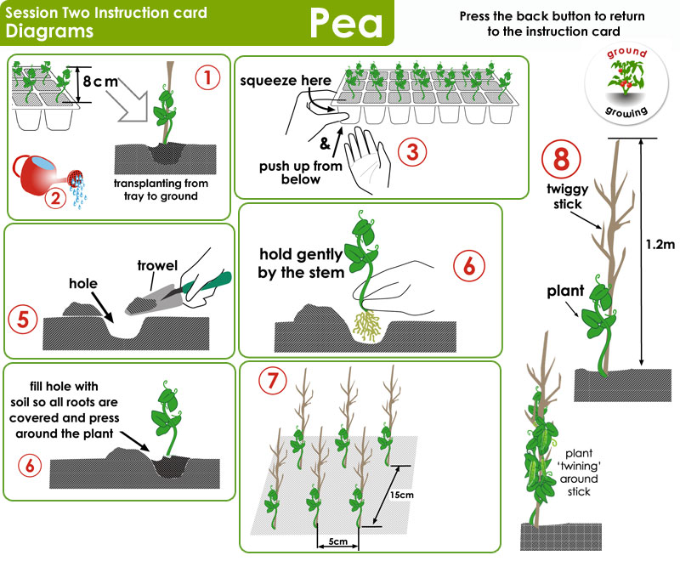
#6 GET VISUAL!
Show the audience visuals along the way.
Add quick/easy photos, diagrams or video clips for each step
Photos/Pictures/Diagrams
Video

Slide 10
#7 GIVE THE AUDIENCE A TIP OR TWO
Did you realize a way to make your skill easier while you were learning it?
Did one tool work better than another?
Did you find a time saving strategy?
Share your new knowledge with the audience! ☺
Example: “I noticed that if I had all of my tools ready before I started, it was much
easier to paint the side of my house. I didn’t have to go back and forth to
the brushes and paints from the garage, and it saved me time!”
Example: “I noticed that the plastic flipper worked much better than the metal one
for flipping the eggs. I recommend you use it instead!”

Slide 11
#8 CHECK YOUR WRITTEN AND PRESENTATION WORK WHEN YOU THINK YOU ARE FINISHED
Are your instructions clear?
Will the audience understand?
Will they be able to use your instructions to SUCCESSFULLY complete/master the skill?
You may need to go back to your instructions and make a few edits. That’s ok! ☺

Slide 12
NOW IT’S YOUR TURN!
These tips can be found in your project booklet
Using them will help people understand and make your presentation as fun as possible! ☺
Have fun and stay safe while you gain your new skill!

